Slide 1
ECE408/CS483 Fall 2016
Applied Parallel Programming
Lecture 4: Kernel-Based
Data Parallel Execution Model

Slide 2
A Multi-Dimensional Grid Example
host
device
Grid 1
Block (0, 0)
Block (0, 1)
Kernel 1
Block (1, 0)
Block (1, 1)
Block (1,1)
(1,0,0)
(1,0,1)
(1,0,2)
(1,0,3)
Thread
(0,0,0)
Thread
(0,0,1)
Thread
(0,0,2)
Thread
(0,0,3)
Thread
(0,0,0)
Thread
(0,1,3)
Thread
(0,1,0)
Thread
(0,1,1)
Thread
(0,1,2)

Slide 4

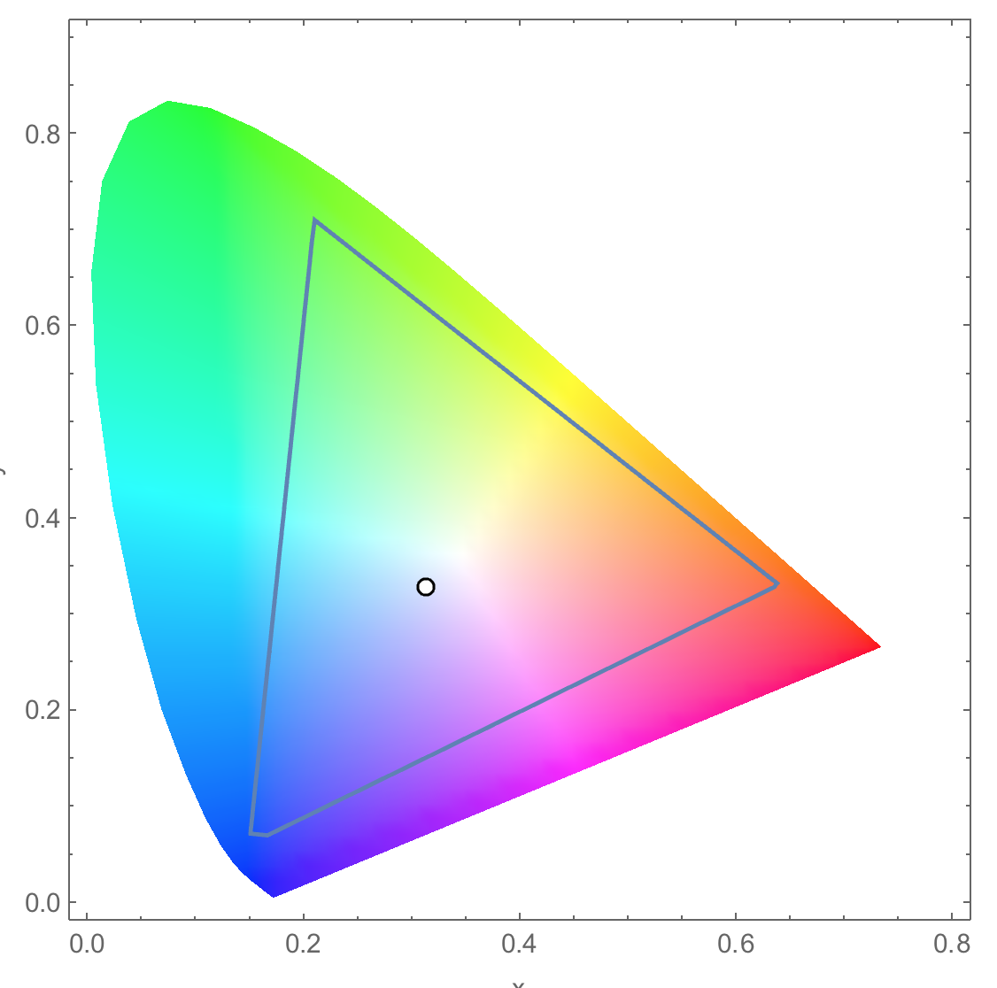
Conversion of a color image to grey–scale image (review)

Slide 5
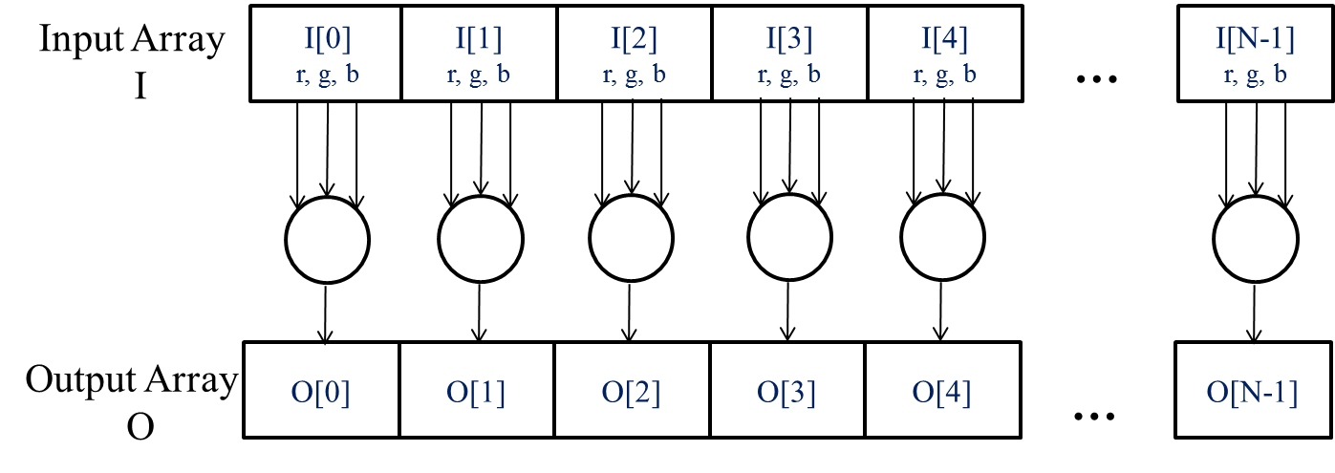
The pixels can be calculated independently of each other (review)

Slide 6
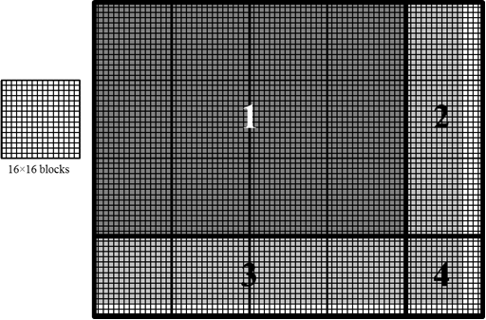
Covering a 76×62 picture with 16×16 blocks
Test (Col < width)

Slide 7
colorToGreyscaleConversion Kernel with 2D thread mapping to data
// we have 3 channels corresponding to RGB
// The input image is encoded as unsigned characters [0, 255]
__global__
void colorToGreyscaleConvertion(unsigned char * Pout, unsigned char * Pin,
int width, int height) {
int Col = threadIdx.x + blockIdx.x * blockDim.x;
int Row = threadIdx.y + blockIdx.y * blockDim.y;
if (Col < width && Row < height) {
// get 1D coordinate for the grayscale image
int greyOffset = Row*width + Col;
// one can think of the RGB image having
// CHANNEL times columns of the gray scale image
int rgbOffset = greyOffset*CHANNELS;
unsigned char r = rgbImage[rgbOffset ]; // red value for pixel
unsigned char g = rgbImage[rgbOffset + 1]; // green value for pixel
unsigned char b = rgbImage[rgbOffset + 2]; // blue value for pixel
// perform the rescaling and store it
// We multiply by floating point constants
grayImage[grayOffset] = 0.21f*r + 0.71f*g + 0.07f*b;
}
}

Slide 8
Row-Major Layout of 2D arrays in C/C++
M_{0,0}
M_{0,1}
M_{0,2}
M_{0,3}
M_{1,0}
M_{1,1}
M_{1,2}
M_{1,3}
M_{2,0}
M_{2,1}
M_{2,2}
M_{2,3}
M_{3,0}
M_{3,1}
M_{3,2}
M_{3,3}
M
M_{0,0}
M_{0,1}
M_{0,2}
M_{0,3}
M_{1,0}
M_{1,1}
M_{1,2}
M_{1,3}
M_{2,0}
M_{2,1}
M_{2,2}
M_{2,3}
M_{3,0}
M_{3,1}
M_{3,2}
M_{3,3}
M
M₀
M₁
M₂
M₃
M₄
M₅
M₆
M₇
M₈
M₉
M₁₀
M₁₁
M₁₂
M₁₃
M₁₄
M₁₅
M_{2,1} → Row*Width+Col = 2*4+1 = 9

Slide 9
colorToGreyscaleConversion Kernel with 2D thread mapping to data (cont.)
// we have 3 channels corresponding to RGB
// The input image is encoded as unsigned characters [0, 255]
__global__
void colorToGreyscaleConvertion(unsigned char * Pout, unsigned char * Pin,
int width, int height) {
int Col = threadIdx.x + blockIdx.x * blockDim.x;
int Row = threadIdx.y + blockIdx.y * blockDim.y;
if (Col < width && Row < height) {
// get 1D coordinate for the grayscale image
int greyOffset = Row*width + Col;
// one can think of the RGB image having
// CHANNEL times columns of the gray scale image
int rgbOffset = greyOffset*CHANNELS;
unsigned char r = rgbImage[rgbOffset ]; // red value for pixel
unsigned char g = rgbImage[rgbOffset + 2]; // green value for pixel
unsigned char b = rgbImage[rgbOffset + 3]; // blue value for pixel
// perform the rescaling and store it
// We multiply by floating point constants
grayImage[grayOffset] = 0.21f*r + 0.71f*g + 0.07f*b;
}
}

Slide 10

Image Blurring

Slide 11
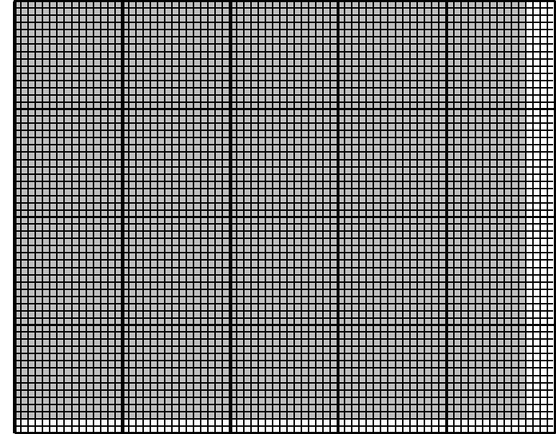
Each output pixel is the average of pixels around it (BLRU_SIZE = 1)
Col
Row

Slide 12
An Image Blur Kernel
__global__
void blurKernel(unsigned char * in, unsigned char * out, int w, int h) {
int Col = blockIdx.x * blockDim.x + threadIdx.x;
int Row = blockIdx.y * blockDim.y + threadIdx.y;
if (Col < w && Row < h) {
1. int pixVal = 0;
2. int pixels = 0;
// Get the average of the surrounding BLUR_SIZE x BLUR_SIZE box
3. for(int blurRow = -BLUR_SIZE; blurRow < BLUR_SIZE+1; ++blurRow) {
4. for(int blurCol = -BLUR_SIZE; blurCol < BLUR_SIZE+1; ++blurCol) {
5. int curRow = Row + blurRow;
6. int curCol = Col + blurCol;
// Verify we have a valid image pixel
7. if(curRow > -1 && curRow < h && curCol > -1 && curCol < w) {
8. pixVal += in[curRow * w + curCol];
9. pixels++; // Keep track of number of pixels in the avg
}
}
}
// Write our new pixel value out
10 out[Row * w + Col] = (unsigned char)(pixVal / pixels);
}
}

Slide 13
Handling boundary conditions for pixels near the edges of the image
3
1
4
2
5

Slide 14
CUDA Thread Block (review)
All threads in a block execute the same kernel program (SPMD)
Programmer declares block:
  Block size 1 to 1024 concurrent threads
  Block shape 1D, 2D, or 3D
Threads have thread index numbers within block
  Kernel code uses thread index and block index to select work and address shared data
Threads in the same block share data and synchronize while doing their share of the work
Threads in different blocks cannot cooperate
  Each block can execute in any order relative to other blocks!
CUDA Thread Block
Thread Id #:
0 1 2 3 … m
Thread program
Courtesy: John Nickolls, NVIDIA

Slide 15
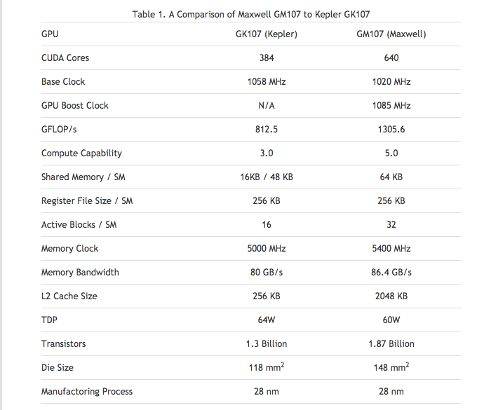
Compute Capabilities are GPU Dependent

Slide 16
Covering a 76×62 picture with 16×16 blocks
Test (Col < width)

Slide 17
Executing Thread Blocks
SM 0
SM 1
t0 t1 t2 … tm
t0 t1 t2 … tm
MT IU
MT IU
Blocks
SP
SP
Threads are assigned to Streaming Multiprocessors in block granularity
  Up to 32 blocks to each SM as resource allows
  Maxwell SM can take up to 2048 threads
Threads run concurrently
  SM maintains thread/block id #s
  SM manages/schedules thread execution
Blocks
Shared
Memory
Shared
Memory

Slide 18
Thread Scheduling (1/2)
Each block is executed as 32-thread warps
  An implementation decision, not part of the CUDA programming model
  Warps are scheduling units in SM
If 3 blocks are assigned to an SM and each block has 256 threads, how many warps are there in an SM?
  Each block is divided into 256/32 = 8 warps
  8 warps/blk * 3 blks = 24 warps
…
Block 1 Warps
…
Block 2 Warps
…
Block 1 Warps
…
…
…
t0 t1 t2 … t31
t0 t1 t2 … t31
t0 t1 t2 … t31
Register File
(128 KB)
L1
(16 KB)
Shared Memory
(48 KB)

Slide 19
Thread Scheduling (2/2)
SM implements zero-overhead warp scheduling
  Warps whose next instruction has its operands ready for consumption are eligible for execution
  Eligible warps are selected for execution on a prioritized scheduling policy
  All threads in a warp execute the same instruction when selected

Slide 20
Single Program Multiple Data (SPMD)
Main performance concern with branching is divergence
  Threads within a single warp take different paths
  Different execution paths are serialized in current GPUs
    The control paths taken by the threads in a warp are traversed one at a time until there is no more.
A common case: divergence could occur when branch condition is a function of thread ID
  Example with divergence:
    If (threadIdx.x > 2) { }
    This creates two different control paths for threads in a block
    Branch granularity < warp size; threads 0, 1 and 2 follow different path than the rest of the threads in the first warp
  Example without divergence:
    If (threadIdx.x / WARP_SIZE > 2) { }
    Also creates two different control paths for threads in a block
    Branch granularity is a whole multiple of warp size; all threads in any given warp follow the same path
Notes:
WARP_SIZE

Slide 21
Block Granularity Considerations
For Matrix Multiplication using multiple blocks, should one use 8X8, 16X16 or 32X32 blocks? Assume that in the GPU used, each SM can take up to 1,536 threads and up to 8 blocks.
  For 8X8, we have 64 threads per block. Each SM can take up to 1536 threads, which is 24 blocks. But each SM can only take up to 8 Blocks, only 512 threads (16 warps) will go into each SM!
  For 16X16, we have 256 threads per block. Since each SM can take up to 1,536 threads (48 warps), which is 6 blocks (within the 8 block limit). Thus we use the full thread capacity of an SM.
  For 32X32, we would have 1,024 threads per Block. Only one block can fit into an SM, using only 2/3 of the thread capacity of an SM.

